Slide 1
Version 1.01
UCSD CSE 30
Computer Organization and Systems Programming
Review Session
Keith Muller

Slide 2
Five Step Workflow in the Linux Environment, Single Source File
#include <stdio.h>
#include <stdlib.h>
/* A simple C Program */
int
main(void)
{
printf("Hello World\n");
return EXIT_SUCCESS;
}
<stdio.h>
<stdlib.h>
% gcc –Wall –Wextra –Werror prog.c
include files have function prototype and other declaration (later slides)
contents of included .h files are inserted/expanded by cpp (c pre-processor phase of gcc) into files prior to compilation start at their position in the file
cpp
prog.c
gcc compile
Source to Execution
Five Step Process
Compile
Assemble
Link
Load
Execute
prog.s
arm32 Assembly (.s)
gcc (gas) Assembler
Object file (.o)
arm32 machine code
partial missing libraries
prog.o
Create a linux process
Load into memory & Execute a.out
ld Linkage Editor
Linux Loader
a.out
Links in already compiled standard c library
Executable in machine code file
libc
x

Slide 3
Background: What is a Definition in a program language?
Definition: creates an instance of a thing
There must be exactly one definition of each function or variable (no duplicates)
In C you must define a variable or a function before first use in your code
Function definition (compiler actions)
creates code you wrote in the functions body
allocates memory to store the code
binds the function name to the allocated memory
Variable definitions (compiler actions)
allocates memory: generate code to allocate space for local variables
initialize memory: generate code to initialize the memory for local variables
binds (or associates) the variable name to the allocated memory
x

Slide 4
Background What is a Declaration in programming language?
Declaration: describes a thing – specifies types, does not create an instance
Function prototype describes (more in a few slides …)
The type of the function return value
The types of each of the parameters
Variable declaration describes
The type of a variable that is defined elsewhere
Derived and defined type description
Later slides:(enums, struct, arrays, unions)
In C, you must declare a function or variable before you use it
Use before declaration will implicitly default to int (and a compiler warning/error – not good)
An identifier can be declared multiple times, but only defined once
A definition is also a declaration in C
x

Slide 5
C Library Function API : Simple Character I/O – Used in PA3
Operation | Usage Examples
Write a char | int status; int c; status = putchar(c); /* Writes to screen stdout */
Read a char | int c; c = getchar(); /* Reads from keyboard stdin */
#include <stdio.h> // import the API declarations
int putchar(int c);
writes c (demoted to a char) to stdout
returns either: c on success OR EOF (a macro often defined as -1) on failure
see % man 3 putchar
int getchar(void);
returns the next input character (if present) promoted to an int read from stdin
see % man 3 getchar
Make sure you use int variables with putchar() and putchar()
Both functions return an int because they must be able to return both valid chars and indicate the EOF condition (-1) is outside the range of valid characters
Why is character I/O using an int?
Answer: Needs to indicate an EOF (-1) condition that is not a valid char
x

Slide 6
Hex to Binary (group 4 bits per digit from the right)
Each Hex digit is 4 bits in base 2 ${ 16}^{1}$ =${ 2}^{4}$
0x f
a
5
3
1111 1010 0101 0011
0b1111101001010011
binary start with a 0b in C
x

Slide 7
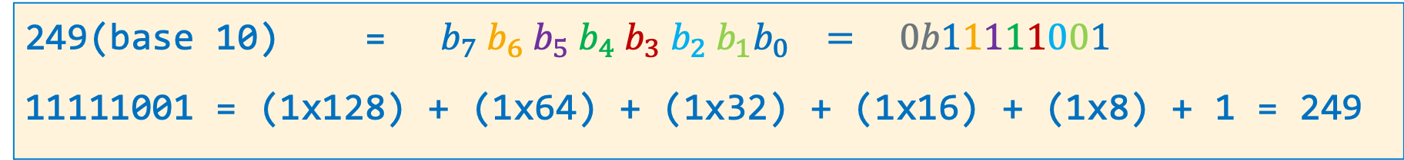
Unsigned Decimal to Unsigned Binary Conversion
dividend 249 | Quotient | Remainder | Bit Position
249/2 | 124 | 1 | b0
124/2 | 62 | 0 | b1
62/2 | 31 | 0 | b2
31/2 | 15 | 1 | b3
15/2 | 7 | 1 | b4
7/2 | 3 | 1 | b5
3/2 | 1 | 1 | b6
1/2 | 0 | 1 | b7
249(base 10) = ${ b}_{7}{ b}_{6}{ b}_{5}{ b}_{4}{ b}_{3}{ b}_{2}{{ b}_{1}b}_{0} = 0b11111001$
11111001 = (1x128) + (1x64) + (1x32) + (1x16) + (1x8) + 1 = 249
x

Slide 8
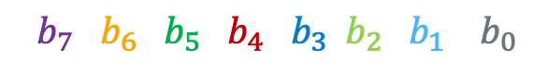
Unsigned Binary to Unsigned Decimal Conversion
What is 0 1 1 0 0 1 0 1(base 2) in decimal (N)?
101(base 10) = (1x64) + (1x32) + (1x4) + 1 (checking the conversion)
$${ b}_{7}{ b}_{6}{ b}_{5}{ b}_{4}{ b}_{3}{ b}_{2}{{ b}_{1} b}_{0}$$
Product Shift Left | Addend | Bit Position | Product
0 | + 0 | b7 | 0
0 | + 1 | b6 | 1
2 x 1 = 2 | + 1 | b5 | 3
2 x 3 = 6 | + 0 | b4 | 6
2 x 6 = 12 | + 0 | b3 | 12
2 x 12 = 24 | + 1 | b2 | 25
2 x 25 = 50 | + 0 | b1 | 50
2 x 50 = 100 | + 1 | b0 | 101
x

Slide 9
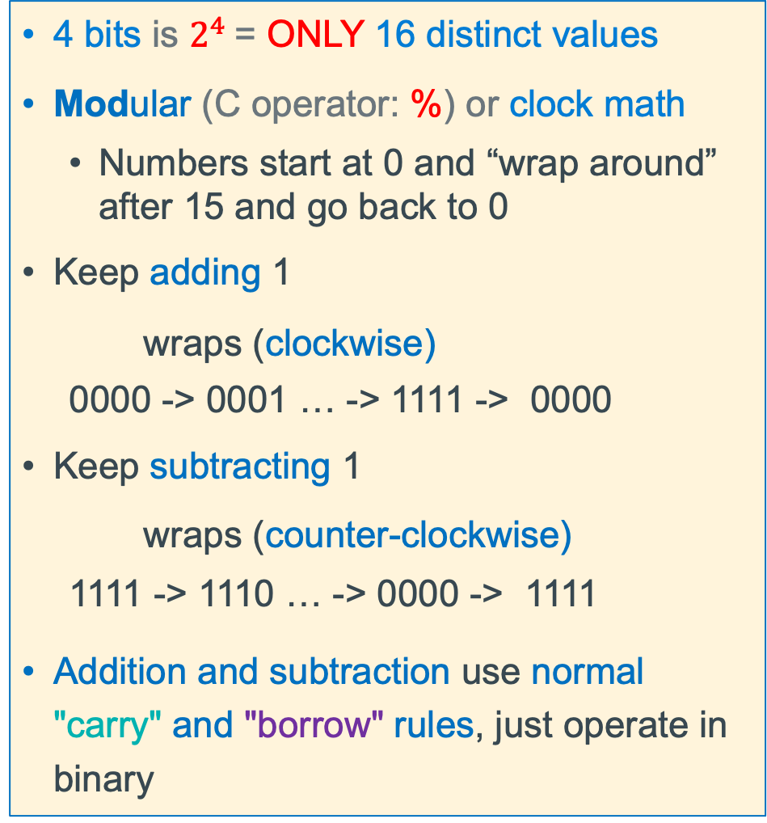
Unsigned Integers (positive numbers) Impact of Fixed # of Bits
4 bits is $2^{4}$= ONLY 16 distinct values
Modular (C operator: %) or clock math
Numbers start at 0 and “wrap around” after 15 and go back to 0
Keep adding 1
wraps (clockwise)
0000 -> 0001 … -> 1111 -> 0000
Keep subtracting 1
wraps (counter-clockwise)
1111 -> 1110 … -> 0000 -> 1111
Addition and subtraction use normal "carry" and "borrow" rules, just operate in binary
x

Slide 10
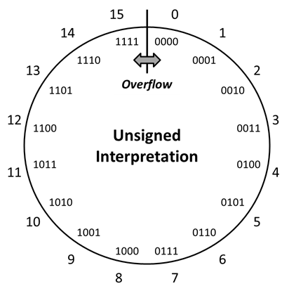
Overflow: Going Past the Boundary Between max and min
max
min
Overflow: Occurs when an arithmetic result (from addition or subtraction for example) is is more than min or max limits
Example shown is for a 4-bit number
C (and Java) ignore overflow exceptions
You end up with a bad value in your program and absolutely no warning or indication… happy debugging!….
x

Slide 11
Unsigned Integer Number Overflow: Addition in 8 bits
Carry
Bit
carries
1
1
1
1
1
1
1
1
only 8 bits for numbers in this example carry bit is always dropped from result
1 0 1 0 0 0 0 1
161
+
0 1 0 1 1 1 1 1
95
sum
0
0
0
0
0
0
0
0
256
Rule: When Carry Bit != 0, overflow has occurred for unsigned integers!
x

Slide 12
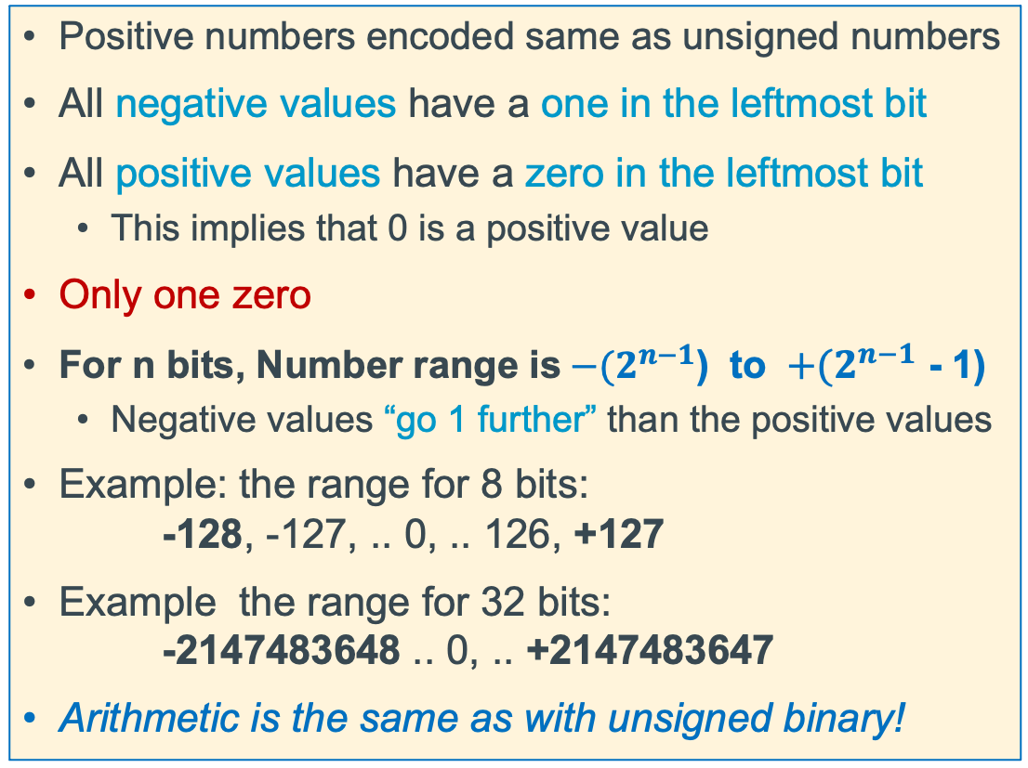
2's Complement Signed Integer Method
Positive numbers encoded same as unsigned numbers
All negative values have a one in the leftmost bit
All positive values have a zero in the leftmost bit
This implies that 0 is a positive value
Only one zero
For n bits, Number range is${ −(2}^{n−1}$) to ${ +(2}^{n−1}$ - 1)
Negative values “go 1 further” than the positive values
Example: the range for 8 bits: -128, -127, .. 0, .. 126, +127
Example the range for 32 bits: -2147483648 .. 0, .. +2147483647
Arithmetic is the same as with unsigned binary!
x

Slide 13
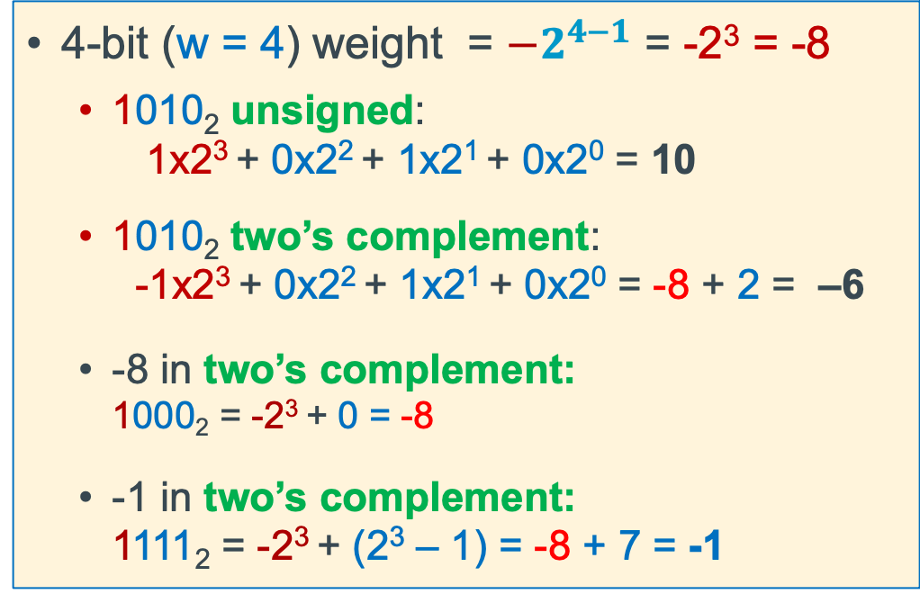
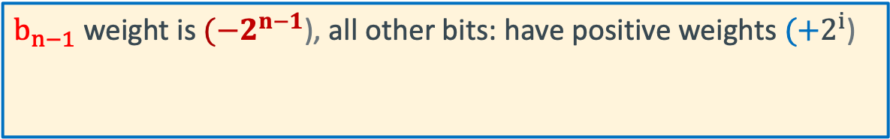
Two’s Complement: The MSB Has a Negative Weight
$$2^{′}s Comp={{−b}_{n−1}2}^{n−1}+ {b_{n−2}2}^{n−2}+ …+ {b_{1}2}^{1}+ b_{0}2^{0}$$
$b_{n−1}$ weight is $(−2^{n−1}$), all other bits: have positive weights $(+2^{i}$)
b_{n-1}
b_{n-2}
. . .
b₀
4-bit (w = 4) weight = $−2^{4−1}$ = -2³ = -8
1010₂ unsigned: 1x2³ + 0x2² + 1x2¹ + 0x2⁰ = 10
1010₂ two’s complement: -1x2³ + 0x2² + 1x2¹ + 0x2⁰ = -8 + 2 = –6
-8 in two’s complement: 1000₂ = -2³ + 0 = -8
-1 in two’s complement: 1111₂ = -2³ + (2³ – 1) = -8 + 7 = -1
x

Slide 14
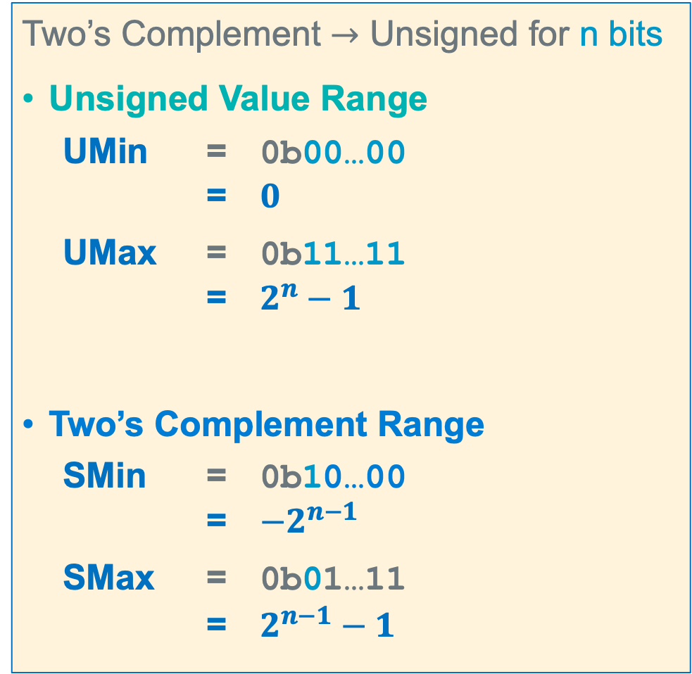
Summary: Min, Max Values: Unsigned and Two’s Complement
Two’s Complement $→$ Unsigned for n bits
Unsigned Value Range
UMin = 0b00…00 = $0$
UMax = 0b11…11 = $2^{n}−1$
Two’s Complement Range
SMin = 0b10…00 = $−2^{n−1}$
SMax = 0b01…11 = $2^{n−1}−1$
For n=4
x

Slide 15
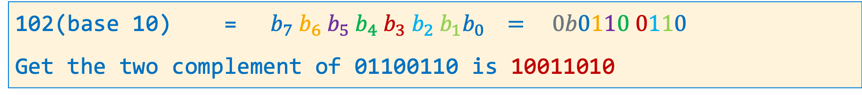
Signed Decimal to Two's Complement Conversion
dividend -102 | Quotient | Remainder | Bit Position
102/2 | 51 | 0 | b0
51/2 | 25 | 1 | b1
25/2 | 12 | 1 | b2
12/2 | 6 | 0 | b3
6/2 | 3 | 0 | b4
3/2 | 1 | 1 | b5
1/2 | 0 | 1 | b6
0/2 | 0 | 0 | b7
102(base 10) = ${ b}_{7}{ b}_{6}{ b}_{5}{ b}_{4}{ b}_{3}{ b}_{2}{{ b}_{1}b}_{0} = 0b0110 0110$
Get the two complement of 01100110 is 10011010
x

Slide 16
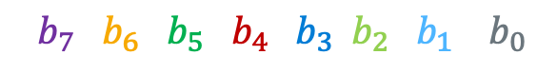
Two's Complement to Signed Decimal Conversion - Positive
What is 0 1 1 0 0 1 0 1(base 2) in decimal (N)?
$${ b}_{7}{ b}_{6}{ b}_{5}{ b}_{4}{ b}_{3}{ b}_{2}{{ b}_{1} b}_{0}$$
Signed Bit Bias | Bit | Bit Position | Bias
-2^{W-1} = -2⁸⁻¹ = -128 | x 0 | b7 | 0
Product Shift Left | Addend | Bit Position | Product
0 | + 1 | b6 | 1
2 x 1 = 2 | + 1 | b5 | 3
2 x 3 = 6 | + 0 | b4 | 6
2 x 6 = 12 | + 0 | b3 | 12
2 x 12 = 24 | + 1 | b2 | 25
2 x 25 = 50 | + 0 | b1 | 50
2 x 50 = 100 | + 1 | b0 | SUM = 101
 |  | Bias + SUM: | 0 + 101 = 101
x

Slide 17
Two’s Complement Positive Overflow
– 1
0
– 2
1111
0000
+ 1
– 3
1110
0001
+ 2
4-bit Two’s complement numbers (positive overflow)
1101
0010
– 4
+ 3
1100
Two’s Complement
0011
Cout
0
1
0
0
1011
0100
– 5
+ 4
0 1 0 1 5
+ 0 1 1 0 6
1010
0101
– 6
1001
0110
+ 5
1 0 1 1 -5 != 11
1000
0111
– 7
+ 6
– 8
+ 7
SMIN
SMAX
Overflow: Occurs when an arithmetic result is beyond the min or max limits
signed numbers: overflow occurs if
operands have same sign and result’s sign is different
x

Slide 18

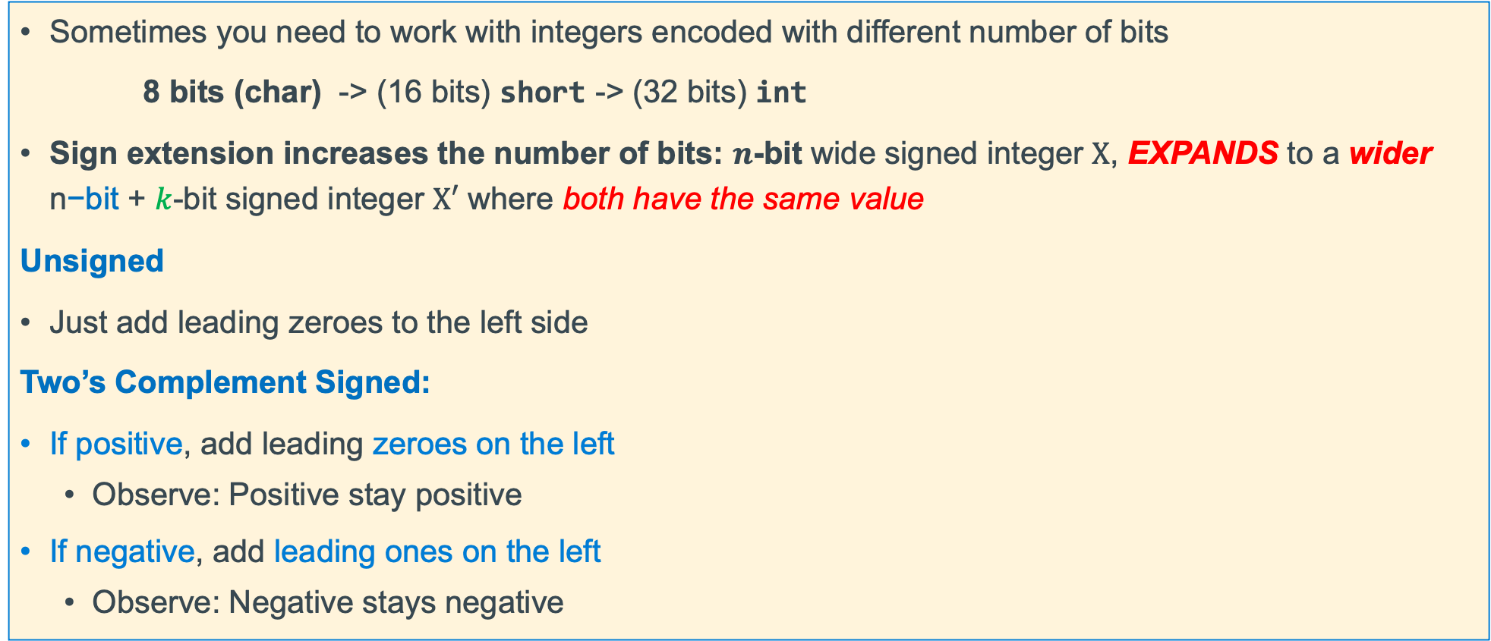
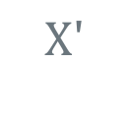

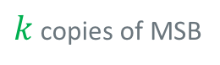
Sign Extension (how type promotion works)
Sometimes you need to work with integers encoded with different number of bits
8 bits (char) -> (16 bits) short -> (32 bits) int
Sign extension increases the number of bits: $n$-bit wide signed integer $X$, EXPANDS to a wider n$\text{−}\text{bit}$ + $k$-bit signed integer $X′$ where both have the same value
Unsigned
Just add leading zeroes to the left side
Two’s Complement Signed:
If positive, add leading zeroes on the left
Observe: Positive stay positive
If negative, add leading ones on the left
Observe: Negative stays negative
n$−bits$
$X$
• • •
• • •
$$Xʹ$$
• • •
• • •
$k$ copies of MSB
original $X \text{n}\text{−}\text{bits}$
x

Slide 19
Example: Two’s Complement Sign or bit Extension - 1
Adding 0's in front of a positive numbers does not change its value
7 = 0111
extend to
8 bits
00000111
Number is still 7
1 = 0001
extend to
8 bits
00000001
Number is still 1
x

Slide 20
Each use of a * operator results in one additional read -2
Each * when used as a dereference operator in a statement (Lside and Rside) generates an additional read
int z = 2, y = 1; int *x;
int *w;
x = &y;
w = &z;
*x = *w;
int z = 2, y = 1;
int *x;
x = &y;
*x = z;
x
2
y
read address
write
x
2
y
z
2
read address
write
read
w
2
z
read address
read
x

Slide 21
Recap: Lside, Rside, Lvalue, Rvalue
Constant Lvalue Rvalue
Var Name address Contents
y 0x108
int x = 2, y = 1;
x = y;
0x1
read
x 0x104
0x1
write
int z = 2, y = 1; int *x;
int *w;
x = &y;
w = &z;
*x = *w;
Constant Lvalue Rvalue
Var Name address Contents
x 0x10c
y 0x108
z 0x104
w 0x100
0x108
read (address)
0x2
write
0x1
*x on Lside is 0x108
w on Rside is 0x100
*w on Rside is 2
0x2
read
0x104
read (address)
x

Slide 22
Background: Different Ways to Pass Parameters
Call-by-reference (or pass by reference)
Parameter in the called function is an alias (references the same memory location) for the supplied argument
Modifying the parameter modifies the calling argument
Call-by-value (or pass by value) (C)
What Called Function Does
Passed Parameters are used like local variables
Modifying the passed parameter in the function is allowed just like a local variable
So, writing to the parameter, only changes the copy
The return value from a function in C is by value
x

Slide 23
Example Using Output Parameters
At the Call to inc() in main()
Allocate space for p
Copy x's address into p
void inc(int *p);
int
main(void)
{
int x = 5;
inc(&x);
printf("%d\n", x);
return EXIT_SUCCESS;
}
void
inc(int *p)
{
if (p != NULL)
*p += 1; // or (*p)++
}
x
6
5
0x1014
Pass the address of x (&x)
0x1010
0x100c
0x1008
0x1004
Receive an address copy (int *p)
p
0x1014
0x1000
Word address
With a pointer to X,
inc() can change x in main()
this is called a side effect
p just like any other local variable
Write to the output variable (*p)
x

Slide 24
Arrays As Parameters: What is the size of the array?
It’s tricky to use arrays as parameters, as they are passed as pointers to the start of the array
In C, Arrays do not know their own size and at runtime there is no “bounds” checking on indexes
int sumAll(int a[]);
int main(void)
{
int numb[] = {9, 8, 1, 9, 5};
int sum = sumAll(numb);
return EXIT_SUCCESS;
}
int sumAll(int a[])
{
int i, sum = 0;
int sz = (int) (sizeof(a)/sizeof(*a));
for (i = 0; i < sz; i++) // this does not work
sum += a[i];
}
}
the name is the address, so this is
passing a pointer to the start of the array
“inside” the body of sumAll(), the question is:
how big is that array? all I have is a POINTER to the first element…..
sz is a 1 on 32 bit arm
x

Slide 25
Arrays As Parameters, Approach 2: Use a sentinel element
A sentinel is an element that contains a value that is not part of the normal data range
Forms of 0 are often used (like with strings). Examples: '\0', NULL
int strlen(char *a);
int main(void)
{
char buf[] = {'a', 'b', 'c', 'd', 'e', '\0'}; // string
printf("Number of chars is: %d\n", strlen(buf));
return EXIT_SUCCESS;
}
1 byte
/* Assumes parameter is a terminated string */
int strlen(char *s)
{
char *p = s;
if (p == NULL)
return 0;
while (*p++)
;
return (p – s - 1);
}
p
0x105
'\0'
same as:
while (*p != '\0')
p = p + 1;
return (p – s);
'e'
0x104
0x103
0x102
0x101
0x100
'd'
'c'
s
'b'
0x100
buf
'a'
0x??
address
x

Slide 26
Array of Pointers: main() : argc, argv Character Address
.% ./extract –c3
(no space between c and 3)
These are the addresses
argv+2
NULL
argv+1
argv+0
*(argv + 1)
*(argv + 1) + 2
*argv or *(argv + 0)
-
c
3
\0
*argv + 8
argv
argc
2
.
/
e
x
t
r
a
c
t
\0
x

Slide 27
main() Command line arguments: argc, argv
NULL
**(argv + 2)
argv+3
argv+2
argv+2
NULL
3
\0
argv+1
argv+1
argv+0
argv+0
*(*(argv + 1) + 1)
*(*(argv + 1)+2)
-
c
\0
-
c
3
\0
argv
**argv
*(*argv + 8)
*(*argv + 8)
argv
**argv
argc
3
.
/
e
x
t
r
a
c
t
\0
argc
2
.
/
e
x
t
r
a
c
t
\0
.% ./extract –c 3
(space between c and 3)
.% ./extract –c3
(No space between c and 3)
x

Slide 28
Process Memory Under Linux
0xFF…FF
OS kernel [protected]
When your program is running it has been loaded into memory and is called a process
Stack segment: Stores Local variables
Allocated and freed at function call entry & exit
Data segment + BSS: Stores Global and static variables
Allocated/freed when the process starts/exits
BSS - Static variables with an implicit initial value
Static Data - Initialized with an explicit initial value
Heap segment: Stores dynamically-allocated variables
Allocated with a function call
Managed by the stdio library malloc() routines
Read Only Data: Stores immutable Literals
Text: Stores your code in machine language + libraries
Stack
Shared Libraries
per process address space
Heap
BSS
Data
Read Only Data
Read Only Text Segment
0x00…00
x

Slide 29
Returning a Pointer To a Local Variable (Dangling Pointer)
There are many situations where a function will return a pointer, but a function must never return a pointer to a memory location that is no longer valid such as:
Address of a passed parameter copy as the caller may or will deallocate it after the call
Address of a local variable (automatic) that is invalid on function return
These errors are called a dangling pointer
n is a parameter with the scope of bad_idea
it is no longer valid after the function returns
int *bad_idea(int n)
{
return &n; // NEVER do this
}
/*
* this is ok to do
* it is NOT a dangling
* pointer
*/
int *ok(int n)
{
static int a = n * n; return &a; // ok
}
a is an automatic (local) with a scope and lifetime within bad_idea2
a is no longer a valid location after the function returns
int *bad_idea2(int n)
{
int a = n * n; return &a; // NEVER do this
}
x

Slide 30
Heap Memory "Leaks"
A memory leak is when you allocate memory on the heap, but never free it
Your program is responsible for cleaning up any memory it allocates but no longer needs
If you keep allocating memory, you may run out of memory in the heap!
Memory leaks may cause long running programs to fault when they exhaust OS memory limits
Make sure you free memory when you no longer need it
Valgrind is a tool for finding memory leaks (not pre-installed in all linux distributions though!)
void
leaky_memory (void)
{
char *bytes = malloc(BLKSZ * sizeof(*bytes));
…
/* code that never passes the pointer in bytes to anything */
return;
}
x

Slide 31
More Dangling Pointers: Reusing "freed" memory
When a pointer points to a memory location that is no longer “valid”
Really hard to debug as the use of the return pointers may not generate a seg fault
dangling_freed_heap() type code often causes the allocators (malloc()and friends) to seg fault
Because it corrupts data structures the heap code uses to manage the memory pool
char *dangling_freed_heap(void)
{
char *buff = malloc(BLKSZ * sizeof(*buff));
…
free(buff);
return buff;
}
x

Slide 32
Copying Structs
You can assign the member value(s) of the whole struct from a struct of the same type – this copies the entire contents!
Individual fields can also be copied
struct date first = {1, 1};
struct date final = {.day= 31, .month= 12};
struct date *pt1 = &first;
struct date *pt2 = &final;
final.day = first.day; // both day are 1
final = first; // copies whole struct
pt2->month = 3;
*pt1 = *pt2; // copies whole struct
pt2->day = 7;
pt1->day = pt2->day; // both days are now 7
first
day
7
1
ptr1
month
3
1
low address
final
day
7
31
1
ptr2
month
1
12
3
low address
x

Slide 33
Struct: Copy and Member Pointers
struct vehicle name = {"CA", "UCSD CSE"};
struct vehicle name2;
struct vehicle {
char *state;
char *plate;
};
plate
"UCSD CSE"
immutable strings
(read only data)
state
"CA"
name
When you assign one struct to another it just copies the member fields!
name2 = name; // copies members Only
"UCSD ECE"
"UCSD CSE"
plate
plate
name2
name
name2.plate = "UCSD ECE";
state
state
Warning
Be very careful with "shallow copies" in C
when pointers are involved
"CA"
x

Slide 34
Struct: Copy and Member Pointers --- "Deep Copy"
struct vehicle {
char *state;
char *plate;
};
struct vehicle name = {"CA", "UCSD CSE"};
struct vehicle name2;
mutable strings (heap memory)
Use strdup() to copy the strings
immutable strings (read-only data)
"UCSD CSE"
"UCSD CSE"
"UCSD ECE"
name2.plate = strdup(name.plate);
name2.state = strdup(name.state);
……
name.plate = "UCSD ECE";
plate
plate
name2
name
state
state
"CA"
"CA"
x

Slide 35
Creating a Node & Inserting it at the Front of the List
// create node; insert at front when passed head
struct node *
creatNode(int year, char *name, struct node *link)
{
struct node *ptr = malloc(sizeof(*ptr));
if (ptr != NULL) {
if ((ptr->name = strdup(name)) == NULL) {
free(ptr);
return NULL;
}
ptr->year = year;
ptr->next = link;
}
return ptr;
}
struct node {
int year;
char *name;
struct node *next;
};
// calling function body
struct node *head = NULL; // insert at front
struct node *ptr;
char buf[BUFSZ];
if (fgets(buf, BUFSZ, stdin) != NULL) { // reads joe
if ((ptr = creatNode(2020, buf, head)) != NULL) {
head = ptr; // error handling not shown
}
}
if (fgets(buf, BUFSZ, stdin) != NULL) { // reads sam
if ((ptr = creatNode(1955, buf, head)) != NULL) {
head = ptr; // error handling not shown
}
}
Must duplicate the string because of buffer reuse
NULL
NULL
head
$$NULL$$
head
2020
"Joe"
head
"Joe"
1955
"Sam"
2020
x

Slide 36
Creating a Node & Inserting it at the End of the List
// create a node and insert at the end of the list
struct node *
insertEnd(int year, char *name, struct node *head)
{
struct node *ptr = head;
struct node *prev = NULL; // base case
struct node *new;
if ((new = creatNode(year, name, NULL)) == NULL)
return NULL;
while (ptr != NULL) {
prev = ptr;
ptr = ptr->next;
}
if (prev == NULL)
return new;
prev->next = new;
return head;
}
head
$$NULL$$
NULL
head
2020
"Joe"
NULL
1955
"Sam"
head
2020
"Joe"
struct node *head = NULL; // insert at end
struct node *ptr;
if ((ptr = insertEnd(2020, "Joe", head)) != NULL)
head = ptr;
if ((ptr = insertEnd(1955, "Sam", head)) != NULL)
head = ptr;
x

Slide 37
How to Access Memory?
0xFF…FF
OS kernel [protected]
Consider a = b + c are operands are in memory
Operation code: add Destination: a
Operand 1: b Operand 2: c
Aarch32 Instructions are always word size: 32 bits wide
Some bits must be used to specify the operation code
Some bits must be used to specify the destination
Some bits must be used to specify the operands
Address space is 32 bits wide so put a POINTER in a register
Stack
Shared Libraries
32-bit Address space
Heap
32 bits wide
Static Data (+BSS)
31 |  |  | 0
Opcode
Destination
Operand 1
Operand 2
Read Only Data
31 | 0
Address of a location in memory
Read Only Text Segment
0x00…00
NOT ENOUGH BITS for FULL Addresses to be stored in the instruction
x

Slide 38
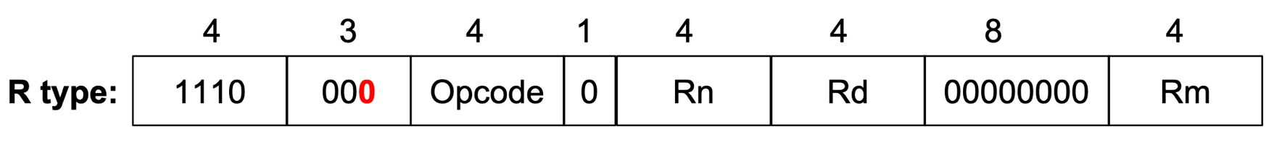
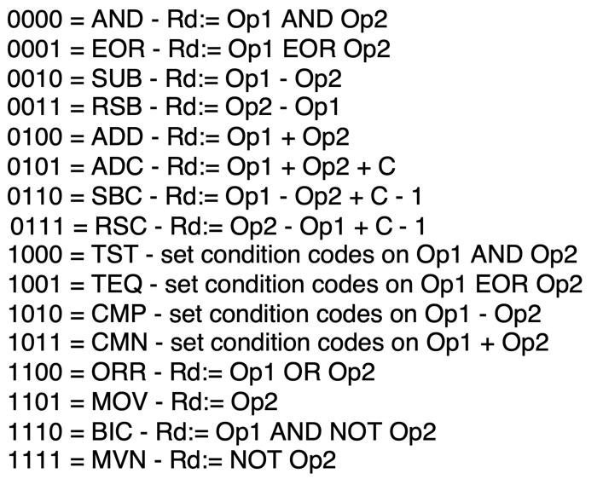
R (register) Type Data Processing: Machine Code
Instructions that process data using three-register arguments
The general instruction format is (not all fields will be in every instruction)
opcode Rd (destination), Rn (operand 1), Rm (operand 2)
add r0, r1, r3
is encoded as
1110 0000 1000 0001 0000 0000 0000 0011
in hex is
0xe0810003
x

Slide 39
Arm Register Summary
16 Named registers r0 – r15
The operands of almost all instructions are registers
To operate on a variable in memory do the following:
Load the value(s) from memory into a register
Execute the instruction
Store the result back into memory (only if needed!)
Going to/from memory is expensive
4X to 20X+ slower than accessing a register
Strategy: Keep variables in registers as much as possible
x

Slide 40
Assembler Directives: .equ and .equiv
.equ BLKSZ, 10240 // buffer size in bytes
.equ BUFCNT, 100*4 // buffer for 100 ints
.equiv STRSZ, 128 // buffer for 128 bytes
.equiv STRSZ, 1280 // ERROR! already defined!
.equ BLKSZ, STRSZ * 4 // redefine BLKSZ from here
.equ <symbol>, <expression>
Defines and sets the value of a symbol to the evaluation of the expression
Used for specifying constants, like a #define in C
You can (re)set a symbol many times in the file, last one seen applies
.equ BLKSZ, 10240 // buffer size in bytes
// other lines
.equ BLKSZ, 1024 // buffer size in bytes
.equiv <symbol>, <expression>
.equiv directive is like .equ except that the assembler will signal an error if symbol is already defined
x

Slide 41
Program Flow: Simple If statement, No Else
Approach: adjust the conditional test then branch around the true block
Use a conditional test that specifies the inverse of the condition used in C
C source Code | Incorrect Assembly | Correct Assembly
int r0; if (r0 > 10) | cmp r0, 10 bgt .Lendif .Lendif: | cmp r0, 10 ble .Lendif .Lendif:
If r0 == 5 true
then fall through to the true block
If r0 == 5 false
then branch around the true block
int r0;
if (r0 == 5) {
/* condition true block */
/* then fall through */
}
/* branch around to this code */
cmp r0, 5
bne .Lendif
/* condition true block */
/* then fall through */
.Lendif:
/* branch around to this code */
x

Slide 42
If with an Else Examples
Branch condition
Test (branch guard)
If r0 < r1 false
then branch to false block
cmp r0, r1
bge .Lelse
mov r2, 1
b .Lendif
.Lelse:
mov r2, 0
/* fall through */
.Lendif:
add r4, r2, r4
…
if (r0 < r1) {
r2 = 1;
// branch around else
} else {
r2 = 0;
/* fall through */
}
r4 = r2 + r4;
condition true block
condition false block
x

Slide 43
Program Flow – Short Circuit or Minimal Evaluation
In evaluation of conditional guard expressions, C uses what is called short circuit or minimal evaluation
Each expression argument is evaluated in sequence from left to right including any side effects (modified using parenthesis), before (optionally) evaluating the next expression argument
If after evaluating an argument, the value of the entire expression can be determined, then the remaining arguments are NOT evaluated (for performance)
if ((x == 5) || (y > 3)) // if x == 5 then y > 3 is not evaluated
if ((a != 0) && func(b)) // if a is 0, func(b) is not called
// do_something();
x

Slide 44
Program Flow – If statements && compound tests - 2
if r0 == 5 false
then short circuit branch to the false block
cmp r0, 5 // test 1
bne .Lelse
cmp r1, 3 // test 2
ble .Lelse
mov r2, r5 // true block
// branch around else
b .Lendif
.Lelse:
mov r5, r2 //false block
// fall through
.Lendif:
mov r4, r3
if ((r0 == 5) && (r1 > 3)) {
r2 = r5; // true block
// branch around else
} else {
r5 = r2; False block */
/* fall through */
}
r4 = r3;
if r1 > 3 false
then branch to the false block
x

Slide 45
Program Flow – If statements || compound tests - 2
cmp r0, 5
beq .Lthen
cmp r1, 3
ble .Lelse
// fall through
.Lthen:
mov r2, r5 // true block
// branch around else
b .Lendif
.Lelse
mov r5, r2 // false block
// fall through
.Lendif:
If r0 == 5 true, then branch to the true block
if r1 > 3 false then branch to false block
if ((r0 == 5) || (r1 > 3)) {
r2 = r5; // true block
/* branch around else */
} else {
r5 = r2; // false block
/* fall through */
}
x

Slide 46
Program Flow – Pre-test and Post-test Loop Guards
loop guard: code that must evaluate to true before the next iteration of the loop
If the loop guard test(s) evaluate to true, the body of the loop is executed again
pre-test loop guard is at the top of the loop
If the test evaluates to true, execution falls through to the loop body
if the test evaluates to false, execution branches around the loop body
post-test loop guard is at the bottom of the loop
If the test evaluates to true, execution branches to the top of the loop
If the test evaluates to false, execution falls through the instruction following the loop
zero or more iterations
one or more iterations
pre-test
loop guard
while (i < 10) {
/* block */
i++;
}
do {
/* block */
i++;
} while (i < 10);
post-test
loop guard
loop control variable
x

Slide 47
Pre-Test Guards - While Loop
.Lwhile:
cmp r1, 10
bge .Lendw
// block
add r1, r1, 1
b .Lwhile
.Lendw:
mov r2, r1
inverted test
pre-test
loop guard
while (r1 < 10) {
/* block */
r1++;
}
r2 = r1;
loop iteration
.Lwhile:
cmp r1, 10
bge .Lendw
cmp r2, r1
beq .Lnext
// block
.Lnext:
add r1, r1, 1
b .Lwhile
.Lendw:
mov r2, r1
pre-test
loop guard
while (r1 < 10) {
if (r2 != r1) {
/* block */
}
r1++;
}
r2 = r1;
if stmt guard
loop iteration
x

Slide 48
Post-Test Guards – Do While Loop
.Ldo:
// block
add r1, r1, 1
cmp r1, 10
blt .Ldo
mov r2, r1
do {
/* block */
r1++;
} while (r1 < 10);
r2 = r1;
loop iteration
test is not inverted
post-test
loop guard
.Ldo:
cmp r2, r1
beq .Lnext
// block
.Lnext
add r1, r1, 1
cmp r1, 10
blt .Ldo
move r2, r1
do {
if (r2 != r1) {
/* block */
}
r1++;
} while (r1 < 10);
r2 = r1;
loop iteration
post-test
loop guard
x

Slide 49
Program Flow – Counting (For) Loop
Pre loop setup
mov r1, 0
.Lfor:
cmp r1, 10
bge .Lendfr
// block code
add r1, r1, 1
b .Lfor
.Lendfr:
Pre loop setup
Pre-test
Loop guard
Post loop update
Pre-test loop guard
for (r1 = 0; r1 < 10; r1++) {
/* block */
}
Post loop update
A counting loop has three parts:
Pre-loop setup
Pre-test loop guard conditions
Post-loop update
Alternative:
move Pre-test loop guard before the loop
Add post-test loop guard
converts to do while
removes an unconditional branch
Alternative
Pre-loop setup
mov r1, 0
cmp r1, 10
bge .Lendfr
.Ldo:
// block code
add r1, r1, 1
cmp r1, 10
blt .Ldo
.Lendfr:
Pre-test loop guard
Post loop update
Post-test loop guard
x

Slide 50
Nested loops
mov r3, 0
.Lfor:
cmp r3, 10 // loop guard
bge .Lendfor
mov r0, 0
.Ldo:
add r0, r0, r1
add r1, r1, 1
cmp r1, 10 // loop guard
blt .Ldo
// fall through
add r2, r2, r1
add r3, r3, 1 // loop iteration
b .Lfor
.Lendfor:
mov r5, r0
for (r3 = 0; r3 < 10; r3++) {
r0 = 0;
do {
r0 = r0 + r1++;
} while (r1 < 10);
// fall through
r2 = r2 + r1;
}
r5 = r0;
Nest loop blocks as you would in C or Java
Do not branch into the middle of a loop, this is hard to read and is prone to errors
x

Slide 51
Bitwise Not (vs Boolean Not)
Bitwise NOT
a | ~a
0 | 1
1 | 0
~ 1100
----
0011
in C
int output = ~a;
 | Bitwise Not
number | 0101 1010 0101 1010 1111 0000 1001 0110
~number | 1010 0101 1010 0101 0000 1111 0110 1001
Meaning | Operator | Operator | Meaning
Boolean NOT | !b | ~b | Bitwise NOT
Boolean operators act on the entire value not the individual bits
Type | Operation | result
bitwise | ~0x01 | 1111 1111 1111 1111 1111 1111 1111 1110
Boolean | !0x01 | 0000 0000 0000 0000 0000 0000 0000 0000
x

Slide 52
Bitwise versus C Boolean Operators
Meaning | Operator | Operator | Meaning
Boolean AND | a && b | a & b | Bitwise AND
Boolean OR | a || b | a | b | Bitwise OR
Boolean NOT | !b | ~b | Bitwise NOT
Boolean operators act on the entire value not the individual bits
& versus &&
0x10 & 0x01 = 0x00 (bitwise)
0x10 && 0x01 = 0x01 (Boolean)
! versus ~
~0x01 = 0xfffffffe (bitwise)
!0x01 = 0x0 (Booelan)
x

Slide 53
Bitwise Instructions
<op>
Rd
Rn
rot4
imm8
<op>
Rd
Rn
Rm
destination
operand 1
Operand 2 constant
destination
operand 1
Operand 2
<op> Rd, Rn, constant // Rd = Rn <op> constant
<op> Rd, constant // Rd = Rd <op> constant
<op> Rd, Rn, Rm // Rd = Rn <op> Rm
Bytes: 0 <= imm8 <= 255 + values from "rotating" rot 4 bits
Bitwise <op> description | C Syntax | Arm <op> Syntax Op2: either register or constant value | Operation
Bitwise AND | a & b | and R_{d}, R_{n}, Op2 | R_{d} = R_{n} & Op2
Bit Clear each bit in Op2 that is a 1, the same bit in R_{d}, is cleared | a & ~b | bic R_{d}, R_{n}, Op2 | R_{d} = R_{n} & ~Op2
Bitwise OR | a | b | orr R_{d}, R_{n}, Op2 | R_{d} = R_{n} | Op2
Exclusive OR | a ^ b | eor R_{d}, R_{n}, Op2 | R_{d} = R_{n} ^ Op2
x

Slide 54
The act (operation) of Masking
Bit masks access/modify specific bits in memory
Masking act of applying a mask to a value with a specific op:
orr: 0 passes bit unchanged, 1 sets bit to 1 (a = b | c; // in C)
eor: 0 passes bit unchanged, 1 inverts the bit (a = b ^ c; // in C)
bic: 0 passes bit unchanged, 1 clears it (a = b & ~c; // in C)
and: 0 clears the bit, 1 passes bit unchanged (a = b & c; // in C)
a = | a₇ | a₆ | a₅ | a₄ | a₃ | a₂ | a₁ | a₀
 | <op> | <op> | <op> | <op> | <op> | <op> | <op> | <op>
b = | b₇ | b₆ | b₅ | b₄ | b₃ | b₂ | b₁ | b₀
result = | c₇ | c₆ | c₅ | c₄ | c₃ | c₂ | c₁ | c₀
x

Slide 55
Extracting (Isolate) a Field of Bits with a mask
extract top 8 bits of r2 into r1
0 to set a bit to 0 ("clears the bit")
1 to let a bit through unchanged
and r1, r2, r3
extract top 8 bits of r2 into r1
DATA: r2 0xab ab ab 77
and r1, r2, 0xff000000
RSLT: r1 0xab 00 00 00
r1 = r2 & 0xff000000; // in C
DATA: r2 0xab ab ab 77
and
MASK: r3 0xff 00 00 00
RSLT: r1 0xab 00 00 00
unchanged
forces to a 0
x

Slide 56
MOD %<power of 2>
Example: %2
DATA: r2 0xab ab ab 77
and
MASK: r3 0x00 00 00 01 (mod 2 even or odd)
RSLT: r1 0x00 00 00 01 (odd)
remainder (mod): num % d where num ≥ 0 and d = 2^{k}
mask = 2^{k} -1 so for mod 16, mask = 16 -1 = 15
and r1, r2, r3
forces to a 0
unchanged
Example: Mod 16
DATA: r2 0xab ab ab 77
and
MASK: r3 0x00 00 00 0f (mod 16)
RSLT: r1 0xab 00 00 07
forces to a 0
unchanged
x

Slide 57
Flipping bits: bit toggle Used in PA8
Example: invert (flip) the lower 8-bits
DATA: r2 0xab ab ab 77
eor
MASK: r3 0x00 00 00 ff
RSLT: r1 0xab ab ab 88
77: 0111 0111
invert (flip) bits "bit toggle" operation
1 will flip the bit
0 to let a bit through
eor r1, r2, r3
Observation: When applied twice, it returns the original value (symmetric encoding)
With a mask of all 1's is a 1's compliment
unchanged
inverts (flips)
88: 1000 1000
DATA: r1 0xab ab ab 88
eor
MASK: r3 0x00 00 00 ff apply a 2nd time
RSLT: r1 0xab ab ab 77 original value!
Example: flip the lower 8-bits
eor r1, r2, 0xff
inverts (flips)
unsigned int r1, r2;
r1 = r2 ^ 0xff;
x

Slide 58
Extracting/Isolating Unsigned Bitfields
Move byte 2 in r0 to byte 0 in r1
Hint: Useful for PA8
31 |  |  |  |  |  |  | 24 | 23 |  |  |  |  |  |  | 16 | 15 |  |  |  |  |  |  | 8 | 7 |  |  |  |  |  |  | 0
 |  |  |  |  |  |  |  | 1 | 0 | 1 | 0 | 1 | 0 | 1 | 0
byte 3
byte 2
byte 1
byte 0
r0
next shift left = 8
pushed bits to far left
31 |  |  |  |  |  |  | 24 | 23 |  |  |  |  |  |  | 16 | 15 |  |  |  |  |  |  | 8 | 7 |  |  |  |  |  |  | 0
1 | 0 | 1 | 0 | 1 | 0 | 1 | 0 |  |  |  |  |  |  |  |  |  |  |  |  |  |  |  |  | 0 | 0 | 0 | 0 | 0 | 0 | 0 | 0
byte 3
byte 2
byte 1
byte 0
lsl r1, r0, 8
unsigned int r0,r1;
r1 = r0 << 8;
r1
Next shift right = 24
pushed bits to far right
31 |  |  |  |  |  |  | 24 | 23 |  |  |  |  |  |  | 16 | 15 |  |  |  |  |  |  | 8 | 7 |  |  |  |  |  |  | 0
0 | 0 | 0 | 0 | 0 | 0 | 0 | 0 | 0 | 0 | 0 | 0 | 0 | 0 | 0 | 0 | 0 | 0 | 0 | 0 | 0 | 0 | 0 | 0 | 1 | 0 | 1 | 0 | 1 | 0 | 1 | 0
byte 3
byte 2
byte 1
byte 0
lsr r1, r1, 24
r1 = r1 >> 24;
r1
unsigned zero-extension (all 0’s)
Extracted bit-field
x

Slide 59
Inserting Bitfields – Inserting Source Field into Destination Field
31 |  |  |  |  |  |  |  |  |  |  |  |  |  |  |  |  |  |  |  |  |  | 8 | 7 |  |  |  |  |  |  |  | 0
other bits |  |  |  |  |  |  |  |  |  |  |  |  |  |  |  |  |  |  |  |  |  |  | source
Task: Insert source into destination
r0
31 |  |  |  |  |  |  | 24 | 23 |  |  |  |  |  |  |  | 16 | 1 5 |  |  |  |  |  |  |  |  |  |  |  |  |  | 0
do not change |  |  |  |  |  |  |  | destination |  |  |  |  |  |  |  |  | do not change
a | b | a | b
0 | 0 | 0
0 | 1 | 1
1 | 0 | 1
1 | 1 | 1
r1
31 |  |  |  |  |  |  | 24 | 23 |  |  |  |  |  |  |  | 16 | 1 5 |  |  |  |  |  |  |  |  |  |  |  |  |  | 0
all zero's |  |  |  |  |  |  |  | source |  |  |  |  |  |  |  |  | all zero's
Approach
(1) isolate source field
(2) clear destination field
(3) Bitwise or together
r2
31 |  |  |  |  |  |  | 24 | 23 |  |  |  |  |  |  |  | 16 | 1 5 |  |  |  |  |  |  |  |  |  |  |  |  |  | 0
do not change |  |  |  |  |  |  |  | all zeros |  |  |  |  |  |  |  |  | do not change
orr r1, r1, r2
r1 = r1 | r2;
r1
results in
31 |  |  |  |  |  |  | 24 | 23 |  |  |  |  |  |  |  | 16 | 1 5 |  |  |  |  |  |  |  |  |  |  |  |  |  | 0
do not change |  |  |  |  |  |  |  | source |  |  |  |  |  |  |  |  | do not change
r1
x

Slide 60
Byte Ordering of Numbers In Memory: Endianness
Two different ways to place multi-byte integers in a byte addressable memory
Big-endian: Most Significant Byte (“big end”) starts at the lowest (starting) address
Little-endian: Least Significant Byte (“little end”) starts at the lowest (starting) address
Example: 32-bit integer with 4-byte data
Little-Endian
Big-Endian
a1
b2
c3
d4
23
0x103
23
0x103
d4
a1
01
0x102
01
0x102
c3
MSB
Most significant byte
LSB
Least significant byte
b2
c3
0x101
b2
0x101
d4
0x100
a1
0x100
x

Slide 61
Byte Ordering Example
Decimal: 12345
Binary: 0011 0000 0011 1001
Hex: 3 0 3 9
int x = 12345;
// or x = 0x00003039; // show all 32 bits
(big-endian)
IA32, ARM32 (little-endian)
0x03
39
00
0x03
0x02
30
00
0x02
0x01
00
30
0x01
0x00
00
39
0x00
x

Slide 62
Loading and Storing: Variations List
Load and store have variations that move 8-bits, 16-bits and 32-bits
Load into a register with less than 32-bits will set the upper bits not filled from memory differently depending on which variation of the load instruction is used
Store will only select the lower 8-bit, lower 16-bits or all 32-bits of the register to copy to memory, register contents are not altered
Instruction | Meaning | Sign Extension | Memory Address Requirement
ldrsb | load signed byte | sign extension | none (any byte)
ldrb | load unsigned byte | zero fill (extension) | none (any byte)
ldrsh | load signed halfword | sign extension | halfword (2-byte aligned)
ldrh | load unsigned halfword | zero fill (extension) | halfword (2-byte aligned)
ldr | load word | --- | word (4-byte aligned)
strb | store low byte (bits 0-7) | --- | none (any byte)
strh | store halfword (bits 0-15) | --- | halfword (2-byte aligned)
str | store word (bits 0-31) | --- | word (4-byte aligned)
x

Slide 63
Loading 32-bit Registers From Memory Variables < 32-Bits Wide
Unsigned
Signed (2’s complement)
Zero-Extend: Add leading 0’s
example ldrb
Sign-Extend: Replicate sign bit
example ldrsb
memory
memory
0b 1110 0001
0b 1110 0001
r0
0xff
0xff
0xff
0xe1
r0
0x00
0x00
0x00
0xe1
Overwrite the upper three bytes with 1
Overwrite the upper three bytes with 0
Instructions that zero-extend:
ldrb, ldrh
Instructions that sign-extend:
ldrsb, ldrsh
x

Slide 64
Storing 32-bit Registers To Memory 8-bit, 16-bit, 32-bit
memory
memory
memory
0x??
0x??
0x??
0xe1
0x??
0x??
0xe2
0xe1
0x04
0x03
0xe2
0xe1
Not Changed
Not Changed
r0
r0
r0
0x00
0x00
0xe2
0xe1
0x00
0x00
0xe2
0xe1
0x04
0x03
0xe2
0xe1
strb
strh
str
x

Slide 65
Array addressing with ldr/str
Array element | Base addressing | Immediate offset | register offset
char ch[0] | ldrb r2, [r0] | ldrb r2, [r0, 0] | mov r4, 0 ldrb r2, [r0, r4]
char ch[1] | add r0, r0, 1 ldrb r2, [r0] | ldrb r2, [r0, 1] | mov r4, 1 ldrb r2, [r0, r4]
char ch[2] | add r0, r0, 2 ldrb r2, [r0] | ldrb r2, [r0, 2] | mov r4, 2 ldrb r2, [r0, r4]
int x[0] | ldr r2, [r1] | ldr r2, [r1, 0] | mov r4, 0 ldr r2, [r1, r4]
int x[1] | add r1, r1, 4 ldr r2, [r1] | ldr r2, [r1, 4] | mov r4, 4 ldr r2, [r1, r4]
int x[2] | add r1, r1, 8 ldr r2, [r1] | ldr r2, [r1, 8] | mov r4, 8 ldr r2, [r1, r4]
0x01
1111
0x00
1110
0x00
1101
0x00
1100
0x01
1011
0x00
1010
0x00
1001
0x00
1000
0x00
0111
0x00
0110
0x00
0101
table rows are
independent instructions not a sequence
r1
..0100
0x45
0100
0x44
0011
0x43
0010
0x42
0001
r0
..0000
0x41
0000

Slide 66
ldr/str practice - 2
r1 contains the Address of X (defined as int *X) in memory r1 points at X
r2 contains the Address of Y (defined as int Y) in memory; r2 points at Y
write Y = *X;
ldr r3, [r1] // r3 ← x (read 1)
ldr r0, [r3] // r0 ← *x (read 2)
str r0, [r2] // y ← *x
0x01010
r3
?
address of y
0x0100c
55
0x01010
r2
Y contents
55
0x0100c
??
0x01008
r1
address of x
0x01004
X = 0x01010
0x01004
??
0x01000
55
r0
?
x

Slide 67
Preview: Return Value and Passing Parameters to Functions (Four parameters or less)
Register | Function Call Use
r0 | 1st parameter
r1 | 2nd parameter
r2 | 3rd parameter
r3 | 4th parameter
Register | Function Return Value Use
r0 | 8, 16 or 32-bit result, 32-bit address or least-significant half of a 64-bit result
r1 | most-significant half of a 64-bit result
Where r0, r1, r2, r3 are arm registers, the function declaration is (first four arguments):
r0 = function(r0, r1, r2, r3) // 32-bit return
r0, r1 = function(r0, r1, r2, r3) // 64-bit return – long long
Each parameter and return value is limited to data that can fit in 4 bytes or less
You receive up to the first four parameters in these four registers
You copy up to the first four parameters into these four registers before calling a function
For parameter values using more than 4 bytes, a pointer to the parameter is passed (we will cover this later)
You MUST ALWAYS assume that the called function will alter the contents of all four registers: r0-r3
In terms of C runtime support, these registers contain the copies given to the called function
C allows the copies to be changed in any way by the called function
x

Slide 68
Using the literal table to fix: Error: invalid constant (3ff) after fixup
In data processing instructions, the field imm8 + rotate 4 bits is too small to store store the immediate value, how do you get larger immediate values into a register?
Answer: use ldr instruction with the constant as an operand: =constant
Assembler creates a literal table entry with the constant
fails
mov r0, 1023
mov
Rd
rot4
imm8
xxx.s:24: Error: invalid constant (3ff) after fixup
replacement
ldr r0, =1023
ldr Rd, =constant // =constant
ldr r1, =0x2468abcd // loads the constant 0x246abcd into r1
x

Slide 69
Preserving lr (and fp): The Foundation of a stack frame
Modifies the link register (lr), writing over main's return address – with the instruction following! Cannot return to main()
int main(void)
{
a();
/* other code */
return EXIT_SUCCESS;
}
int a(void)
{
b();
/* other code */
return 0;
}
int b(void)
{
/* other code */
return 0;
}
Saves the return address in LR
Saves the return address in LR
● ● ● bl a ● ● ● | a: ● ● ● bl b ● ● ● bx lr | b: ● ● bx lr
Uh No
Infinite loop!!!
Copies the saved return address from lr back into pc
Copies the saved return address from lr back into pc
x

Slide 70
Preserving lr (and fp): The Foundation of a stack frame
Saves the return address in LR
Fix: Save the contents of fp, lr on the stack.
int main(void)
{
a();
/* other code */
return EXIT_SUCCESS;
}
int a(void)
{
b();
/* other code */
return 0;
}
int b(void)
{
/* other code */
return 0;
}
● ● ● bl a ● ● ● | a: ● ● ● bl b ● ● ● bx lr | b: ● ● bx lr
Fix: Save the contents of fp, lr on the stack.
push {fp, lr}
pop {fp, lr}
push {fp, lr}
pop {fp, lr}
Restores the contents of fp, lr from the stack.
Copies the saved return address from lr back into pc
Copies the saved return address from lr back into pc
Restores the contents of fp, lr from the stack.
The frame pointer is used to find variables on the stack – later
x

Slide 71
push: Multiple Register Save (str to stack)
stack segment high memory
CPU registers to Save
save registers
push{r4-r6, r8, fp, lr}
copy
If you have no stack variables (later) then always push an EVEN number of registers!
sp before push
lr
saved lr
fp
saved fp
allocated space
(# registers) * (4 bytes)
Registers are pushed on to the stack in order
right (high memory) to left (low memory)
r8
saved r8
r6
saved r6
r5
saved r5
r4
saved r4
sp after push
stack segment low memory
push copies the contents of the {reg list} to stack segment memory
push Also subtracts (# of registers saved) * (4 bytes) from the sp to allocate space on the stack
sp = sp – (# registers_saved * 4)
this must always be true: sp % 8 == 0
x

Slide 72
pop: Multiple Register Restore (ldr from stack)
stack segment high memory
restore registers
pop{r4-r6,r8,fp,lr}
CPU registers
copy
sp after pop
lr
saved lr
Registers are pop’d from the stack in order
left (low memory) to right (high memory)
fp
saved fp
Restored register contents
r8
saved r8
deallocated space
(# registers) * (4 bytes)
r6
saved r6
r5
saved r5
r4
saved r4
sp before pop
stack segment low memory
pop copies the contents of stack segment memory to the {reg list}
pop adds: (# of registers restored) * (4 bytes) to sp to deallocate space on the stack
sp = sp + (# registers restored * 4)
Remember: {reg list} must be the same in both the push and the corresponding pop
x

Slide 73
Local Variables are Part of Each Stack Frame
Local variables are on the stack below the lowest numbered saved (pushed) register
saved lr
#define BFSZ 4
int main(void)
{
char buf[BFSZ]; // BFSZ bytes
...
saved fp
saved register
saved register
buf[BFSZ-1]
buf[BFSZ]
saved lr
BFSZ
fp
saved fp
sp
buf[0]
sp
x

Slide 74
Stack Frame (Arm Arch32 Procedure Call Standards)
Stack Frame Requirements
Minimal frame: at function entry push {fp, lr}
The top two entries in a stack frame are always (1) saved lr, (2) saved fp
sp points at top element in the stack (lowest byte address)
fp points at the lr copy stored in the current stack frame
Stack frames MUST ALWAYS BE aligned to 8-byte addresses
So, this must always be true: sp % 8 == 0
high address
low address
lr & fp must always be at top of frame
saved lr
fp
saved fp
sp
minimal frame above
Always save at least fp and lr
and set fp at saved lr
Stack high address
allocate stack space
SP = SP – "space"
grows "down"
int main(void)
{
a();
/* other code */
return EXIT_SUCCESS;
}
int a(void)
{
int x;
int y;
/* other code */
return 0;
}
main's
frame
main
saved lr
fp
saved fp
sp
a
saved lr
fp
deallocate stack space
SP = SP + "space"
shrinks "up"
a's
frame
saved fp
preserved registers
sp
Local variables
low address
sp
Note slide has builds
x

Slide 75
FP_OFF: Distance from FP to SP Used to set FP at push and SP before pop
after push {r4-r7,fp,lr}
add fp, sp, FP_OFF
// other code etc .equ FP_OFF, 20
main:
push {r4-r7, fp, lr}
add fp, sp, FP_OFF …….
sub sp, fp, FP_OFF
pop {r4-r7, fp, lr}
bx lr
Function Prologue
always at top of function saves regs and sets fp
saved lr
fp = sp + 20 bytes
saved fp
Function Epilogue
always at bottom of function restores regs including the sp
saved r7
FP_OFF:
Where to set FP after push
Function Stack Frame
saved r6
saved r5
saved r4
sp
# regs saved | FP_OFF in Bytes
2 | 4
3 | 8
4 | 12
5 | 16
6 | 20
7 | 24
8 | 28
9 | 32
low memory
4-byte words
Means Caution, odd number of regs!
If odd number pushed, make sure frame is 8-byte aligned (later)
this must always be true: sp % 8 == 0
FP_OFF = (#regs - 1)*4 // -1 is lr offset from sp
Where # regs = #preserved + lr + fp
IMPORTANT: FP_OFF has two uses:
Where to set fp after prologue push (remember sp position)
Restore sp (deallocate locals) right before epilogue pop
x

Slide 76
Function Prologue and Epilogue: Minimum Stack Frame
Each function has only one Prologue at the top of the function body and only one Epilogue at the bottom of the function body
When you want to exit the function, set the return value in r0, and then branch (or fall through) to the epilogue
Function entry (Function Prologue):
save preserved registers
set the fp to point at saved lr
allocate space for locals
(subtracts from sp)
Function return (Function Epilogue):
deallocate space for locals (adds to sp)
restores preserved registers
return to caller
smallest frame has:
4 bytes between sp & fp
saved lr
fp
saved fp
sp
low memory
.global one
.type one, %function
.equ FP_OFF, 4
one:
push {fp, lr}
add fp, sp, FP_OFF // add space for locals
// your code
sub sp, fp, FP_OFF
pop {fp, lr}
bx lr // func return
.size one, (. – one)
Function Header Assembly directives
Function Prologue always at top of function
Position the fp
Position the sp
Function Epilogue
always at bottom of function
Function Footer Assembly directive
x

Slide 77
Function Prologue: Allocating the Stack Frame
Allocate Space for locals
ldr r3, =FRMADD
sub sp, sp, r3
at function entry
after
push {r4,r5,fp,lr}
Set FP
add fp, sp, FP_OFF
saved lr
fp
saved lr
fp
saved lr
saved lr
saved fp
sp
saved fp
saved fp
saved fp
saved lr
saved lr
fp
saved lr
fp
New Stack Frame
saved fp
saved fp
saved fp
saved r5
callers r5
FP_OFF
saved r5
FP_OFF
saved r4
sp
callers r4
sp
saved r4
Local Variables
low memory
low memory
low memory
FRMADD
sp
low memory
Function saves lr, fp using a push and only those preserved registers it wants to use on the stack
Do not push r12 or r13
Function was just called this how the stack looks
The orange blocks are part of the caller's stack frame
Function moves the fp to point at the saved lr as required by the Aarch32 spec
Allocate Space for Local Variables
Part of function prologue
x

Slide 78
Function Epilogue: Deallocating the Stack Frame
Deallocate Space for locals
Put SP back so pop works
sub sp, fp, FP_OFF
At function exit after
pop {r4,r5,fp,lr}
Stack frame while during function body execution
saved lr
fp
saved lr
saved lr
saved fp
sp
saved fp
saved fp
saved lr
saved lr
fp
saved lr
fp
saved fp
saved fp
saved fp
saved r5
Eligible for reuse
out of scope
saved r5
FP_OFF
saved r5
FP_OFF
saved r4
saved r4
saved r4
sp
Local Variables
Local Variables
Local Variables
FRMADD
Deallocated
sp
low memory
low memory
low memory
Use fp as a pointer to find local variables on the stack
Move SP back to where it was after the push in the prologue. So, the pop works properly (this also deallocates the local variables)
At function exit (in the function epilogue) the function uses pop to restore the registers to the values they had at function entry
Part of function epilogue
x

Slide 79
Review Return Value and Passing Parameters to Functions (Four parameters or less)
Register | Function Call Use
r0 | 1st parameter
r1 | 2nd parameter
r2 | 3rd parameter
r3 | 4th parameter
Register | Function Return Value Use
r0 | 8, 16 or 32-bit result, 32-bit address or least-significant half of a 64-bit result
r1 | most-significant half of a 64-bit result
Where r0, r1, r2, r3 are arm registers, the function declaration is (first four arguments):
r0 = function(r0, r1, r2, r3) // 32-bit return
r0, r1 = function(r0, r1, r2, r3) // 64-bit return – long long
Each parameter and return value is limited to data that can fit in 4 bytes or less
You receive up to the first four parameters in these four registers
You copy up to the first four parameters into these four registers before calling a function
For parameter values using more than 4 bytes, a pointer to the parameter is passed (we will cover this later)
You MUST ALWAYS assume that the called function will alter the contents of all four registers: r0-r3
Observation: When a function calls another function, the called function has the right to overwrite the first 4 parameters that were passed to it by the calling function
x

Slide 80
Accessing argv from Assembly (stderr version)
.extern printf
.extern stderr
.section .rodata
.Lstr: .string "argv[%d] = %s\n"
.text
.global main // main(r0=argc, r1=argv)
.type main, %function
.equ FP_OFF, 20
main:
push {r4-r7, fp, lr}
add fp, sp, FP_OFF
ldr r4, =stderr // get the address of stderr
ldr r4, [r4] // get the contents of stderr
ldr r5, =.Lstr // get the address of .Lstr
mov r6, 0 // set indx = 0;
mov r7, r1 // save argv
.Lloop:
// fprintf(stderr, "argv[%d] = %s\n", indx, argv[indx])
ldr r3, [r7] // argv[indx]
cmp r3, 0 // check argv[indx]==NULL
beq .Ldone // if so done
mov r2, r6 // indx
mov r1, r5 // "argv[%d] = %s\n"
mov r0, r4 // stderr
bl fprintf
add r6, r6, 1 // indx++
add r7, r7, 4 // argv++
b .Lloop
.Ldone:
mov r0, 0
sub sp, fp, FP_OFF
pop {r4-r7, fp, lr}
bx lr
% ./cipher -e -b in/BOOK
argv[0] = ./cipher
argv[1] = -e
argv[2] = -b
argv[3] = in/BOOK
Function Prologue
always at top of function saves regs and sets fp
in/book
Registers
argv[]
-b
r3
r2
r1
r0
-e
./cipher
**argv
argc
Function Epilogue
always at bottom of function Branch to this to exit the function restores regs including the sp

Slide 81
Local Variables on the Stack
Local variables are on the stack below the lowest numbered saved register
frame pointer is used as a pointer to stack variables
fp is the base register in ldr and str instructions
Example load buf[0] into r4
FP_OFF = 12, BUFSZ = 4
Distance from FP is buf[0] is 12 + 4 = 16
ldrb r4, [fp, -16]
saved lr
fp
#define BFSZ 4
int main(void)
{
char buf[BFSZ]; // BFSZ bytes
...
FP_OFF
distance from fp to lowest saved register
saved fp
saved register
saved register
BFSZ + FP_OFF
buf[BFSZ-1]
buf[BFSZ]
BFSZ
Calculate how much additional space is needed by all the local variables
After the register save push, Subtract from the sp the size of the variable in bytes (+ padding - later slides)
buf[0]
sp
x

Slide 82
Function prologue with local variables
add space for local variables!
Stack after push
saved lr
fp
saved lr
saved fp
fp
FP_OFF
stack frame
size
saved fp
stack
frame
saved regs
stack frame
FP_OFF
saved reg
saved regs
saved reg
local var
FRMADD
sp
local var
sp
push {fp, lr}
add fp, sp, FP_OFF
low memory
.equ FRMADD, 8
push {fp, lr}
add fp, sp, FP_OFF
ldr r3, =FRMADD // frames may be large sub sp, sp, r3
// your code
move the sp to allocate space on the stack for local variables and outgoing parameters (later)
x

Slide 83
Function epilogue with local variables
add space for local variables!
For pop to restore the registers correctly:
sp must point at the last saved preserved register put on the stack by the save register operation: the push
saved lr
fp
saved fp
FP_OFF
stack
frame
saved regs
saved regs
add space for local variables!
local var
FRMSZ
local var
saved lr
fp
sp
saved fp
low memory
FP_OFF
stack
frame
saved regs
.equ FRMADD, 8
push {fp, lr}
add fp, sp, FP_OFF ldr r3, =FRMADD sub sp, sp, r3
// your code
sub sp, fp, FP_OFF
pop {fp, lr}
bx lr // func return
saved regs
sp
local var
FRMSZ
local var
low memory
Return the sp (using the fp) to the same address it had after the push operation sub sp, fp, FP_OFF
this works no matter how much space was allocated in the prologue
x

Slide 84
Stack Frame Design – Local Variables
integer
4 bytes
Arrays start at a 4-byte boundary (even arrays with only 1 element)
Exception: double arrays [ ] start at an 8-byte boundary
struct arrays are aligned to the requirements of largest member
Space padding (0 or 4 bytes) when necessary is added at the high address end of a variables allocated space, based on the variable's alignment and the requirements of variable below it on the stack
Single chars (and shorts) can be grouped together in same 4-byte word (following the alignment for the short)
After all the variables have been allocated, add padding at stack frame bottom (low memory) so the total stack frame size (including all saved registers) is a multiple of 8 when the prologue is finished
short
2 bytes
char
1
int
a[1]
a[0]
0
E
D
C
B
A
pointer
Pad (as needed)
x

Slide 85
Step 2 Generate Distance offsets from [fp]
saved lr
fp
Use the assembler to calculate the distance from the address contained in fp [fp, -offset]
.equ FP_OFF, 12
.equ X, 4+FP_OFF // X = 16
.equ A, 4+X // A = 20
Assign label names for each local variable
Each name is .equ to be the offset from fp
saved fp
saved regs
12 bytes
saved regs
[fp, -FP_OFF]
int x
4
[fp, -X]
a[1]
a[0]
4
Variable name | Size | Name | expression size + prev | Distance from fp
Pushed regs-1 | 12 | FP_OFF |  | 12
int x | 4 | X | 4 + FP_OFF | 16
short a[] | 4 | A | 4 + X | 20
char str[] | 8 | STR | 8 + A | 28
char *ptr | 4 | PTR | 4 + STR | 32
PAD Added | 4 | PAD | 4 + PTR | 36
FRMADD |  | FRMADD | PAD-FP_OFF | 24
[fp, -A]
0
E
8
FRMADD = PAD – FP_OFF
D
C
B
A
[fp, -STR]
pointer ptr
4
[fp, -PTR]
Pad 4 bytes
4
sp
[fp, -PAD]
x

Slide 86
Step 3 Allocate Space in the Prologue
.global func
.type func, %function
.equ FP_OFF, 12
.equ X, 4 + FP_OFF
.equ A, 4 + X
.equ STR, 8 + A
.equ PTR, 4 + STR
.equ PAD, 4 + PTR
.equ FRMADD PAD - FP_OFF
func:
push {r4, r5, fp, lr}
add fp, sp, FP_OFF
ldr r3, =FRMADD //frames can be large
sub sp, sp, r3 // add space for locals
// rest of function code
// no change to epilogue
sub sp, fp, FP_OFF // deallocate locals
pop {r4, r5, fp, lr}
bx lr
.size func, (. – func)
saved lr
fp
saved fp
saved regs
12 bytes
saved regs
[fp, -FP_OFF]
int x
4
[fp, -X]
a[1]
a[0]
4
[fp, -A]
0
E
8
FRMADD = PAD – FP_OFF
D
C
B
A
[fp, -STR]
pointer ptr
4
[fp, -PTR]
Pad 4 bytes
4
sp
[fp, -PAD]
x

Slide 87
Accessing Stack using distance offsets
saved lr
fp
var | stack variable address into r0 | stack variable contents into r0
x | ldr r0, =X sub r0, fp, r0 | ldr r0, =X ldr r0, [fp, -r0]
a[0] | ldr r0, =A sub r0, fp, r0 | ldr r0, =A ldrsh r0, [fp, -r0]
a[1] | ldr r0, =A - 2 sub r0, fp, r0 | ldr r0, =A - 2 ldrsh r0, [fp, -r0]
str[1] | ldr r0, =STR - 1 sub r0, fp, r0 | ldr r0, =STR - 1 ldrb r0, [fp, -r0]
ptr | ldr r0, =PTR sub r0, fp, r0 | ldr r0, =PTR ldr r0, [fp, -r0]
*ptr | ldr r0, =PTR sub r0, fp, r0 ldr r0, [r0] | ldr r0, =PTR ldr r0, [fp, -r0] ldr r0, [r0]
saved fp
saved regs
12 bytes
saved regs
[fp, -FP_OFF]
int x
4
[fp, -X]
a[1]
a[0]
4
[fp, -A]
0
E
8
FRMADD = PAD – FP_OFF
D
C
B
A
var | write contents of r0 to stack variable
ptr | ldr r1, =PTR str r0, [fp, -r1]
*ptr | ldr r1, =PTR ldr r1, [fp, -r1] str r0, [r1]
[fp, -STR]
pointer ptr
4
[fp, -PTR]
Pad 4 bytes
4
sp
[fp, -PAD]
x

Slide 88
Passing Pointers to Stack Variables
#include <stdio.h>
#include <stdlib.h>
#include <errno.h>
#define BUFSZ 4096 // copies input to output
int
main(void) {
char buf[BUFSZ];
size_t cnt; // assign to a register only
// read from stdin, up to BUFSZ bytes
// and store them in buf
// Number of bytes read is in cnt
while ((cnt = fread(buf, 1, BUFSZ, stdin)) > 0) {
// write cnt bytes from buf to stdout
if (fwrite(buf, 1, cnt, stdout) != cnt) {
return EXIT_FAILURE;
}
}
return EXIT_SUCCESS;
}
saved lr
fp
saved fp
Data Segment
Global Variables
saved r7
saved r6
stdin:
stdout:
FILE *
struct
saved r5
FILE *
struct
saved r4
buf[BUFSZ]
buf[0]
sp
.text
.global main
.type main, %function // stack frame below
.equ BUFSZ, 4096
.equ FP_OFF, 20 // fp offset in main stack frame
.equ BUF, BUFSZ+FP_OFF// buffer
.equ PAD, 0+BUF // Stack frame PAD
.equ FRMADD, PAD-FP_OFF // space for locals+passed args

Slide 89
Reading and Writing bytes using C library routines fread() and fwrite()
.text
.global main
.type main, %function // stack frame below, distances from fp
.equ BUFSZ, 4096
.equ FP_OFF, 20 // fp offset in main stack frame
.equ BUF, BUFSZ+FP_OFF// buffer
.equ PAD, 0+BUF // Stack frame PAD
.equ FRMADD, PAD-FP_OFF // space for locals+passed args
// save values in preserved registers
ldr r4, =BUF // distance from fp
sub r4, fp, r4 // pointer to buffer
ldr r5, =stdin // standard input global
ldr r5, [r5]
ldr r6, =stdout // standard output global
ldr r6, [r6]
// fread(buffer, element_size, number of elements, FILE *)
// fread(r0=buf, r1=1, r2=BUFSZ, r3=stdin)
mov r0, r4 // buf
mov r1, 1 // bytes
mov r2, BUFSZ // cnt (or ldr r2, =BUFSZ)
mov r3, r5 // stdin
bl fread
cmp r0, 0 // check return value from fread
saved lr
fp
saved fp
saved r7
FP_OFF
saved r6
BUF=
FP_OFF +
BUFSZ
saved r5
saved r4
// fwrite(buffer, element_size, number of elements, FILE *)
// fwrite(r0=buf, r1=1, r2=cnt, r3=stdout)
mov r0, r4 // buf
mov r1, 1 // bytes
mov r2, r7 // cnt
mov r3, r6 // stdout
bl fwrite
cmp r0, r7 // check return value from fwrite
buf[BUFSZ]
BUFSZ
buf[0]
sp

Slide 90
Writing Function: Receiving a Pointer Parameter - 2
r0, r1, r2
void
fillbuf(char *s, int len, char fill)
{
char *enptr = s + len;
while (s < enptr)
*(s++) = fill;
}
Using r1 for endptr
fillbuf:
push {fp, lr} // stack frame
add fp, sp, FP_OFF // set fp to base
add r1, r1, r0 // copy up to r1 = bufpt + cnt
cmp r0, r1 // are there any chars to fill?
bge .Ldone // nope we are done
.Ldowhile:
strb r2, [r0] // store the char in the buffer
add r0, 1 // point to next char
cmp r0, r1 // have we reached the end?
blt .Ldowhile // if not continue to fill
.Ldone:
sub sp, fp, FP_OFF // restore stack frame top
pop {fp, lr} // restore registers
bx lr // return to caller
saved lr
saved fp
buf[BFSZ-1]
buf[BFSZ]
r1
buf[0]
r0
saved lr
fp
saved fp
sp
x

Slide 91
Passing More Than Four Arguments – At the point of Call
r0 = function(r0, r1, r2, r3, arg5, arg6, … argn)
arg1, arg2, arg3, arg4, ...
Stack segment
high memory
Args > 4 are in the caller's stack frame at SP (argv5), an up
Called functions have the right to change stack args just like they can change the register args!
Caller must assume all args including ones on the stack are changed by the caller
Calling function prior to making the call
Evaluate first four args: place resulting values in r0-r3
Store Arg 5 and greater parameter values on the stack
One arg value per slot! – NO arrays across multiple slots
chars, shorts and ints are directly stored
Structs (not always), and arrays are passed via a pointer
Pointers passed as output parameters usually contain an address that points at the stack, BSS, data, or heap
saved lr
fp
saved fp
calling functions stack frame
saved regs
local
variables
PAD (if needed)
arg n
….
arg 6
arg 5
sp
r3
arg 4
r2
arg 3
r1
arg 2
r0
arg 1 & return
Temporary Registers
x

Slide 92
Calling Function: Allocating Stack Parameter Space
Previous stack frame
At the point of a function call (and obviously at the start of the called function):
sp must point at arg5
arg5 must be at an 8-byte boundary,
padding to force arg5 alignment is placed above the last argument the called function is expecting
Approach: Extend the stack frame to include enough space for stack arguments function with the greatest arg count
Examine every function call in the body of a function
Find the function call with greatest arg count, Determines space needed for outgoing args
Add the space needed to the frame layout
saved lr
fp
Preserved registers
local vars
saved fp
rest of frame
Callers stack frame
Outgoing arg space part of calling functions frame
PAD (if needed)
arg 9
arg 8
arg 7
arg 6
arg 5
sp
Rules: At point of call
arg5 must be pointed at by sp
SP must be 8-byte aligned
x

Slide 93
Calling Function: Pass ARGS 5 and higher
.equ FP_OFF, 4
.equ CNT, 8 + FP_OFF // int cnt[2];
.equ PAD, 4 + CNT // added as needed
.equ OARG9, 4 + PAD
.equ OARG8, 4 + OARG9
.equ OARG7, 4 + OARG8
.equ OARG6, 4 + OARG7
.equ OARG5, 4 + OARG6
.equ FRMADD OARG5 – FP_OFF
Previous stack frame
Preserved registers
local vars
fp
saved lr
saved fp
cnt[2]
Callers stack frame
Outgoing arg space part of calling functions frame
PAD
oarg9
var | write contents
OARG5 = r1 | ldr r0, =OARG5 //distance str r1, [fp, -r0]
OARG6 = &cnt | ldr r2, =CNT //distance sub r2, fp, r2 // &cnt ldr r0, =OARG6 //distance str r2, [fp, -r0]
oarg8
oarg7
oarg6
oarg5
sp
Rules: At point of call
arg5 must be pointed at by sp
SP must be 8-byte aligned
x

Slide 94
Called Function: Retrieving Args From the Stack
At function start and before the push{} the sp is at an 8-byte boundary
Args are in the caller's stack frame and arg 5 always starts at fp+4
Additional args are higher up the stack, with one “slot” every 4-bytes
This "algorithm" for finding args was designed to enable variable arg count functions like printf("conversion list", arg0, … argn);
saved lr
saved fp
rest of frame
PAD
arg9
fp+20
Callers Stack frame
no defined limit to number of args, keep going up stack 4 bytes at a time
arg8
fp+16
int func(int a1, int a2, int a3, int a4,
short a5, int a6, char a7, int a8, int a9)
???
arg7
fp+12
arg6
fp+8
Constant | Offset | arm ldr /str statement
ARGN | (N-4)*4 | ldr r4, [fp, ARGN]
ARG9 | 20 | ldr r4, [fp, ARG9]
ARG8 | 16 | ldr r4, [fp, ARG8]
ARG7 | 12 | ldrb r4, [fp, ARG7]
ARG6 | 8 | ldr r4, [fp, ARG6]
ARG5 | 4 | ldrh r4, [fp, ARG5]
???
arg5
fp+4
lr to caller
fp
Current Stack Frame
callers fp
.equ ARG9, 20
.equ ARG8, 16
.equ ARG7, 12
.equ ARG6, 8
.equ ARG5, 4
Saved Registers
Local variables
sp
Rule: Called functions always access stack parameters using a positive offset to the fp
x

